Slide 1


Voice Assistent for Vehicles BCW 26’ Hackathon
Team: CANALS
10.06.2026

Slide 2
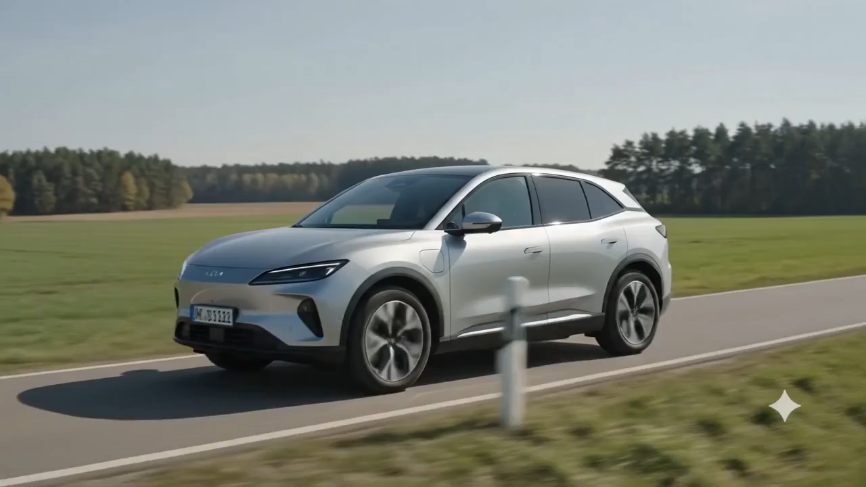

Slide 3
Problem Statement
A voice that drives with you, even when the cloud doesn‘t
Electric vehicle runs out of battery,
you are looking for the next EV Charge,
But there is not internet connection

Slide 4
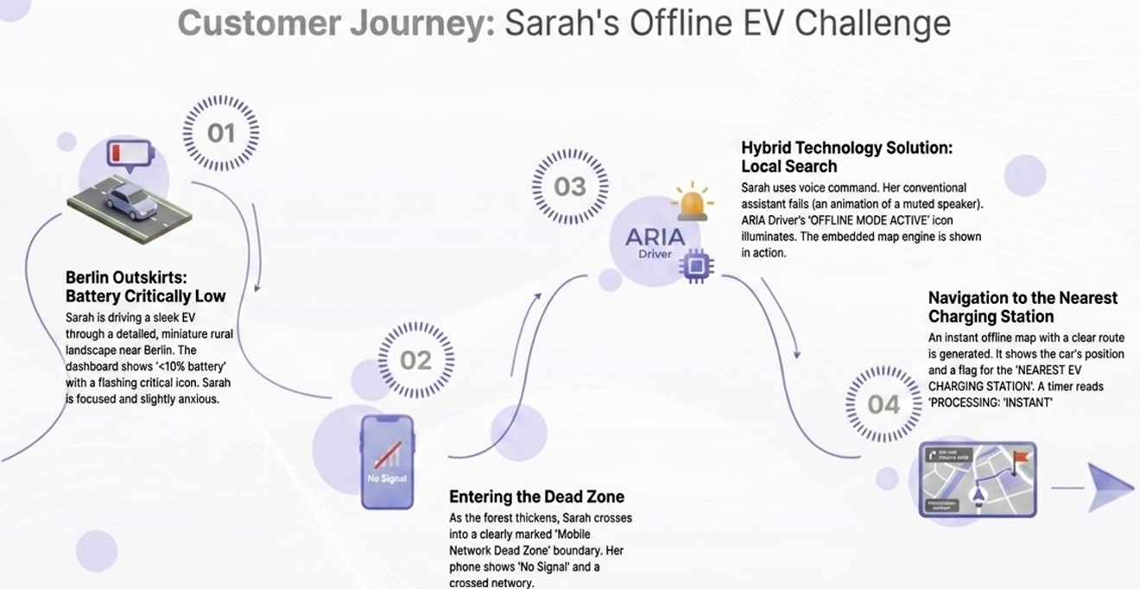
Solution
A voice that drives with you, even when the cloud doesn‘t

Slide 5
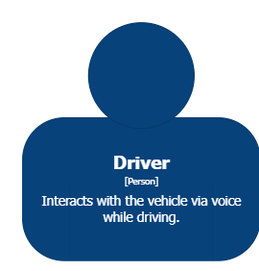
High-Level Overview
A voice that drives with you, even when the cloud doesn‘t
Cloud
Orchestrator Layer
Offline / Cached Database

Slide 6

High-Level Overview
A voice that drives with you, even when the cloud doesn‘t
Cloud
Orchestrator
Layer
Offline / Cached Database

Slide 7
Efficiency Gains
A voice that drives with you, even when the cloud doesn‘t
Functionality without internet
Rural areas and Tunnels are covered
Saving cloud cost
Intelligent use of available infrastructure
Cost saving by 50%
Data Security
Improved security due to local/on-prem execution
Increase CX, differentiating functionality

Slide 8
Next Steps
A voice that drives with you, even when the cloud doesn‘t
MVP
Proving Functionality
- Finding a collaboration partner to test hypothesis
1st Production Version
Roll-Out with first vehicles in series
- Reaching beak-even point
2nd Product Version
Evolution of Product
- Implementing more functionalities
Develop together with us the next generation of hybrid car intelligence

Slide 9
04
Backup
Customer Journey
Program Flow
Techn. Architecture

Slide 10
Solution
A voice that drives with you, even when the cloud doesn‘t

Slide 11
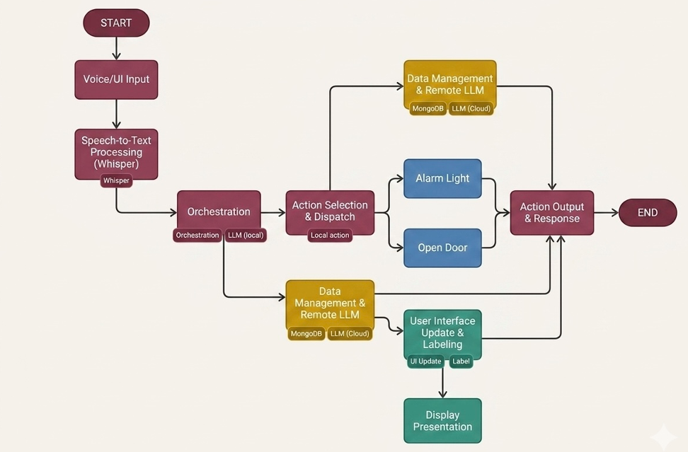
Program Flow
A voice that drives with you, even when the cloud doesn‘t

Slide 12
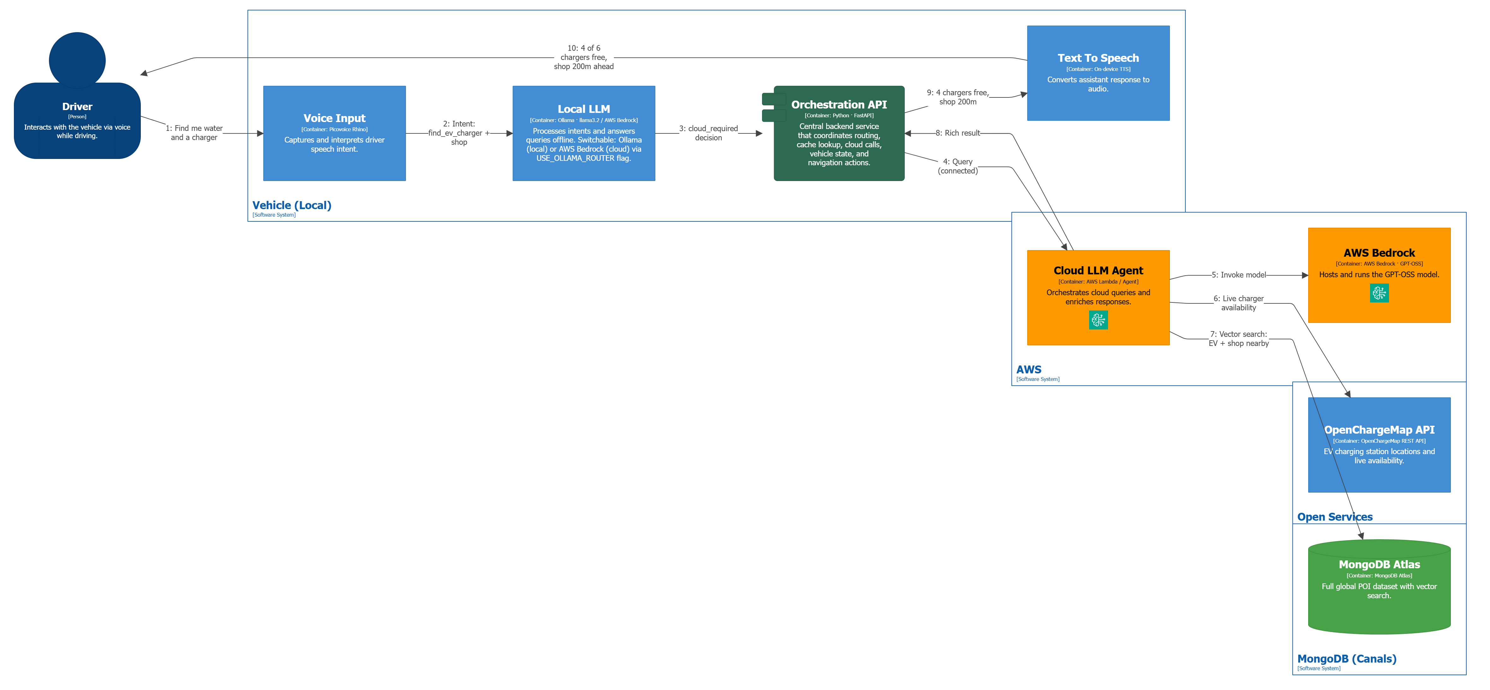
Technical Architecture
A voice that drives with you, even when the cloud doesn‘t

